Slide 1
Starting eBox...

Slide 2
eBox
Copyright © 2014-2017 eBox Corporation.
Copyright © 2009-2017 BubbleSoft & PC.
The best Virtual Machine Manager.

Slide 3
Booting BubbleSoft Windows Codename Bobcat...

Slide 5

ZaphkielCorp© Code Name
Bobcat

Slide 7
BubbleSoft Bindows Codenamed “Bobcat”
Only for testing purposes. Build 4089

Slide 8

Please wait while Bobcat starts up.

Slide 9
CTRL+ALT+SUPR
Press Ctrl+Alt+Supr to login

Slide 10
Administrator

Slide 11
Logging in…

Slide 12
Starting Group Policy Service…

Slide 13
Waiting for Bobcat Updates Service…

Slide 14
Waiting for .net Server…

Slide 15
Logging in…

Slide 17
BubbleSoft Bindows Codenamed “Bobcat”
Only for testing purposes. Build 4089

Slide 18


BubbleSoft Bindows Codenamed “Bobcat”
Only for testing purposes. Build 4089

Slide 19



Support Bobcat
Notes of the
lastest release
of Bobcat
BubbleSoft Bindows Codenamed “Bobcat”
Only for testing purposes. Build 4089

Slide 20

Administrator
Support Bobcat
Preferences
Customize your computer.
Quick Start
Notes of the
lastest release
of Bobcat
BubbleSoft Bindows Codenamed “Bobcat”
Only for testing purposes. Build 4089
Turn off computer

Slide 21

System Preferences
X
Preferences
Coming soon more settings!
preferences
Support Bobcat
User Accounts
Notes of the
lastest release
of Bobcat
BubbleSoft Bindows Codenamed “Bobcat”
Official version. Build 4074

Slide 22
User Accounts
X
Support Bobcat
Administrator
Owner
Notes of the
lastest release
of Bobcat
OK
BubbleSoft Bindows Codenamed “Bobcat”
Official version. Build 4074

Slide 23
Notes of the lastest release of Bobcat.
X
Bobcat Build 4089 (under construction)
Features
-Now with compartibility for ZaphkielXP programs
This is all for now. You can send feedback at Support Bobcat.
Thanks!
-The Bobcat Team
Support Bobcat
Notes of the
lastest release
of Bobcat
BubbleSoft Bindows Codenamed “Bobcat”
Only for testing purposes. Build 4089

Slide 24

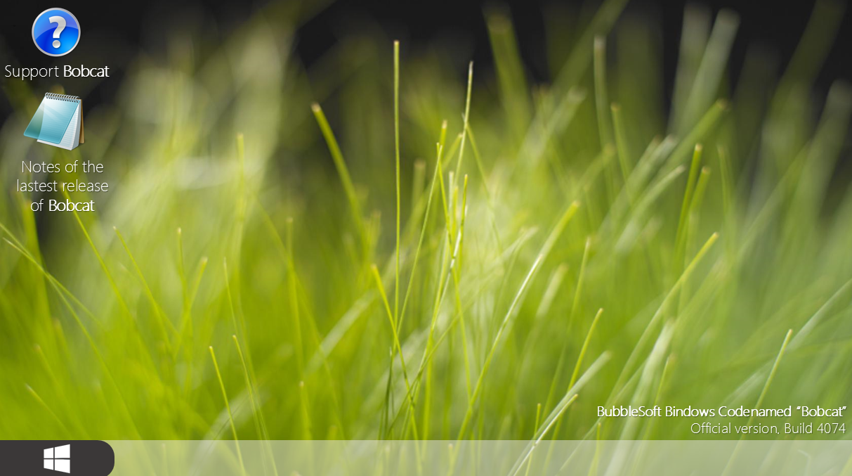
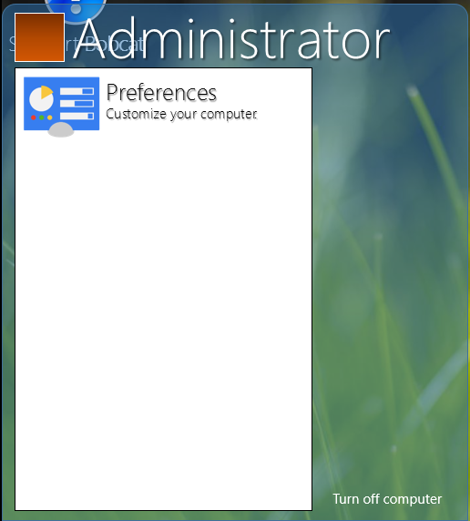
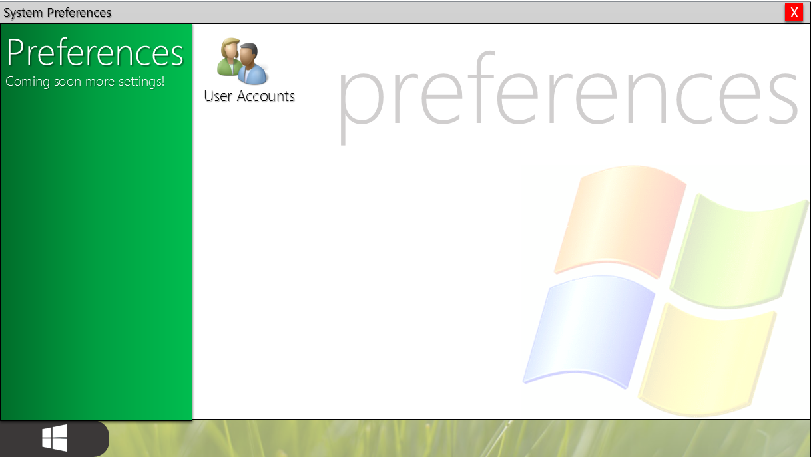
Support Bobcat
X
Welcome to Support Bobcat!
Support Bobcat
You can send feedback to BubbleSoft for Suggestions, SDK, Bugs, Glitches
and criticizes!
Comments?
Notes of the
lastest release
of Bobcat
Nice aero styled start menu. :)
“Control Panel” renamed to
“Preferences”
All of your applications are located on Start Menu.
BubbleSoft Bindows Codenamed “Bobcat”
Official version. Build 4074

Slide 25
Support Bobcat
X
Welcome to Support Bobcat!
Support Bobcat
You can send feedback to BubbleSoft for Suggestions, SDK, Bugs, Glitches
and criticizes!
Send feedback about Bobcat.
OK
X
Tell us what is the problem.
Comments?
Notes of the
lastest release
of Bobcat
Nice aero styled start menu. :)
“Control Panel” renamed to
“Preferences”
All of your applications are located on Start Menu.
BubbleSoft Bindows Codenamed “Bobcat”
Official version. Build 4074

Slide 26
Support Bobcat
X
Welcome to Support Bobcat!
Support Bobcat
You can send feedback to BubbleSoft for Suggestions, SDK, Bugs, Glitches
and criticizes!
Send feedback about Bobcat.
X
Comments?
Notes of the
lastest release
of Bobcat
Nice aero styled start menu. :)
Thanks! We work hard to improve our operating systems.
OK
“Control Panel” renamed to
“Preferences”
All of your applications are located on Start Menu.
BubbleSoft Bindows Codenamed “Bobcat”
Official version. Build 4074

Slide 27
ZaphkielCorp WebApplication
X
About WebApplication
BubbleSoft Bindows Codenamed “Bobcat”
Official version. Build 4074

Slide 28
ZaphkielCorp WebApplication
X
ZaphkielCorp WebApplication
Version 4.0
Want to make your own WA program? Download the SDK
Back
BubbleSoft Bindows Codenamed “Bobcat”
Official version. Build 4074

Slide 29
Support Bobcat
A application needs permission to continue
X
An application needs permission to continue
Notes of the
lastest release
of Bobcat
Application: QuickStart.bat
Producer: BubbleSoft Corporation
Status: Trust in this application, It’s signed by BubbleSoft
OK
BubbleSoft Bindows Codenamed “Bobcat”
Only for testing purposes. Build 4089

Slide 30
Support Bobcat
Please wait…
Quick Start
by BubbleSoft.
Notes of the
lastest release
of Bobcat
BubbleSoft Bindows Codenamed “Bobcat”
Only for testing purposes. Build 4089

Slide 31
exit quick start
Programs recentely used:
Recent email:
Turn off computer

Slide 32

Support Bobcat
Turn off your computer
X
Notes of the
lastest release
of Bobcat
¿Are you sure if you want to turn off your computer?
Press the “X” to cancel
Turn off
BubbleSoft Bindows Codenamed “Bobcat”
Only for testing purposes. Build 4089

Slide 33
BubbleSoft Bindows Codenamed “Bobcat”
Only for testing purposes. Build 4089

Slide 34
Logging off…

Slide 35
Shutting down Group Policy Service…

Slide 36
Waiting for UpdateZap Service…

Slide 37
Waiting for .net Server…

Slide 38
Logging off…

Slide 39
Please wait while Bobcat shutdown your computer.

